Slide 1
IOT BASED REAL TIME WEATHER MONITORING STATION
SUBMITTED BY
SILPA S PILLAI
TVE20MCA-2050
S4 MCA(2020-2022)

Slide 2
INTRODUCTION
Project proposes an idea of IoT based live weather monitoring station.
A weather station can be described as an instrument or device, which provides us with the information of the weather in our neighbouring environment.
It is a device that collects data related to the weather & environment using different sensors.
Hence, this device basically senses the temperature, pressure, humidity and rain value.
It can be used to monitor the temperature or humidity of a particular room/place ,we can monitor the atmospheric pressure of the room as well as monitor the rain value.
Whenever the possibility of rain value exceed a chosen threshold limit for each a telegram alert will notify the owner of the appliance to take necessary measure.

Slide 3
LITERATURE REVIEW
(1)Puja Sharma, Shiva Prakash “Real Time Weather Monitoring System Using Iot”ITM Web of Conferences 40, 01006 (2021) Department of Information Technology and Computer Application ,Madan Mohan Malaviya University of Technology, Gorakhpur.
Proposed a robust and affordable IoT based weather station.
The environmental parameters can be retrieved through sensors.
In this system uses node MCU 8266, and various sensors.
A temperature and humidity sensor, pressure sensor, rain sensor are used in the system.

Slide 4
LITERATURE REVIEW
(2)Roopa M L, Varsharani, Prathima S M, Rashmi H C” IOT based Real Time Weather Predication System using NODEMCU 12-E ESP266 and Lab” International Journal of Engineering Research & Technology (IJERT), ISSN: 2278-0181,NCCDS – (2021) Conference Proceedings.
Electronic sensors are used to review and monitor the weather parameters.
The project is implemented using Node MCU ESP-8266 with WiFi inbuilt used for TCP/ IP protocol in the smart phone for wireless remote monitoring.
An Integrated TCP/IP protocol stack is used for transmitting and receiving sensor information.
The NodeMCU-12E controls the entire weather Prediction system peripherals and status on a Blynk app / web page or mobile application.
DHT11 Humidity & Temperature Sensor, BMP280 Barometric Pressure Sensor and FC37 Rain Sensor with NodeMCU ESP8266-12E wi-fi Module.

Slide 5
LITERATURE REVIEW
(3)Jamal Mabrouki , Mourade Azrour, Driss Dhiba, Yousef Farhaoui,Souad El Hajjaji” IoT-Based Data Logger for Weather Monitoring Using Arduino-Based Wireless Sensor Networks with Remote Graphical Application and Alerts” ISSN 2096-0654 04/07 pp25–32 Volume 4, Number 1, March 2021 DOI: 10.26599/BDMA.2020.9020018.
System proposes an automatic weather monitoring system that allows having dynamic and real-time climate data of a given area.
Based on the internet of things technology and embedded system.
The system includes electronic devices, sensors, and wireless technology.
The main objective of this system is sensing the climate parameters, such as temperature, humidity, and existence of some gases, based on the sensors.
The captured values can then be sent to remote applications or databases. Afterwards, the stored data can be visualized in graphics and tables form.

Slide 6
EXISTING SYSTEM
Live environmental condition is one of the biggest issues because there is an IoT of hurdles arrives when live environmental condition is measured.
There are two types of weather stations, one which is having own sensors and the second type is of where we pull data from the weather station servers. Existing system is of the latter type.
Existing system is highly expensive.
Devices that monitor weather parameters with minimum cost in our proposed system rather than existing system.
The system which is designed has used less sensor than the existing model.

Slide 7
PROPOSED SYSTEM
Presents an IoT-based weather monitoring system.
The environmental parameter can be retrieved through sensors.
The proposed system uses different sensors to scale the various parameters like humidity, temperature, pressure, rain value.
Proposes an additional functionality of the weather monitoring as alert system based on the exceed value of the sensing parameters like rain value.
The sensor captured data and send it to the MCU controller, where it loads the sensor data and can be displayed in the serial monitor and I2c OLED display.
Arduino ide is used to upload the sensed data.
Displays the data on the webserver and monitor the real-time data of weather.
The main aim of our proposed model is to make the system cost-effective, affordable. So that everyone can use it freely. In our proposed system, capturing multiple data from multiple sensors and send all the data to the webpage.

Slide 8
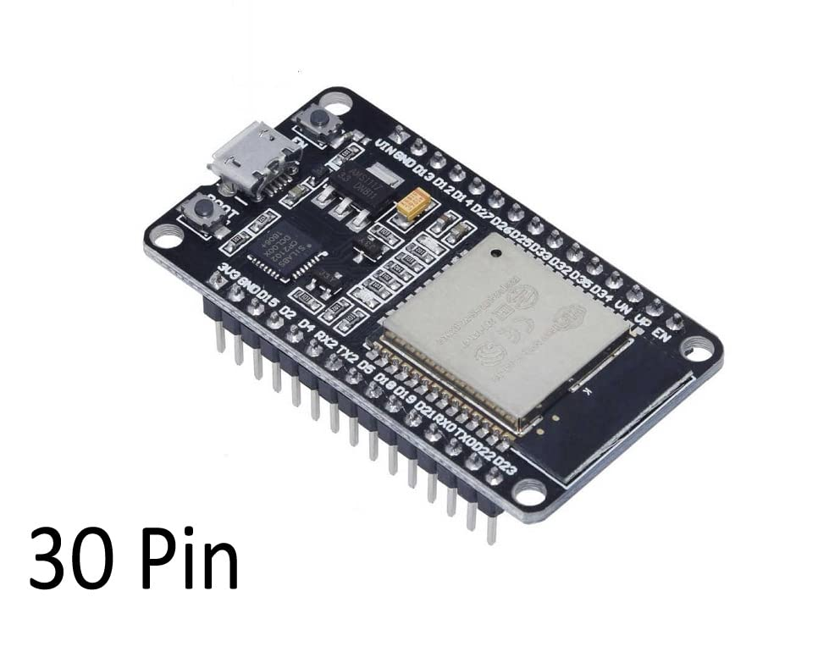
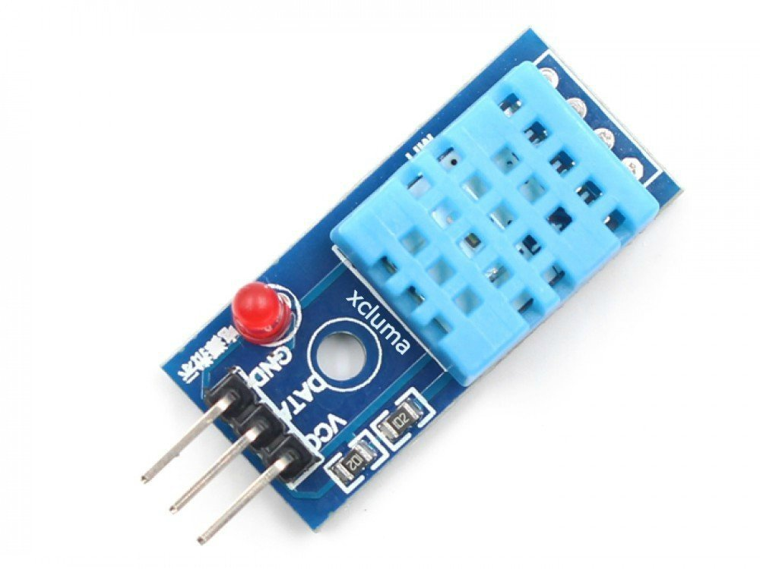
COMPONENTS
ESP32 MICROCONTROLLER
DHT11 TEMPERATURE AND HUMIDITY SENSOR

Slide 9
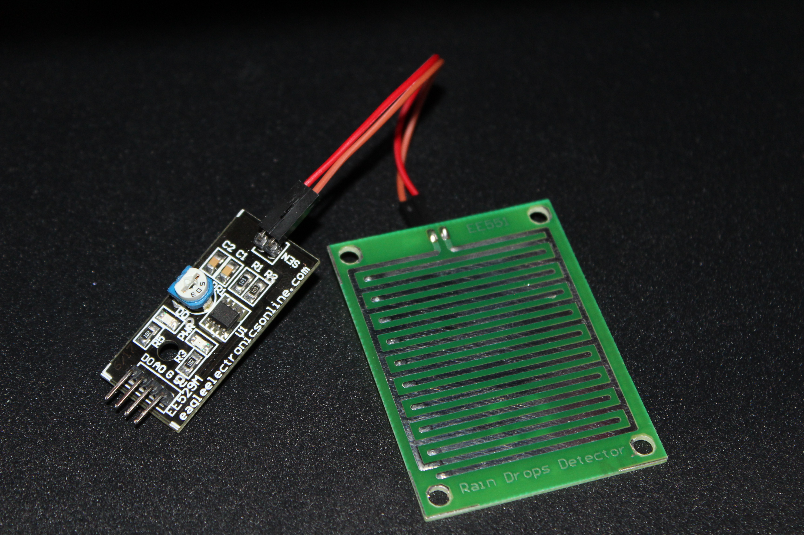
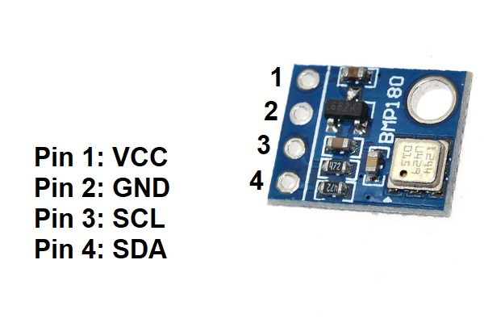
COMPONENTS
BMP180 BAROMETRIC SENSOR
RAIN DROP MODULE

Slide 10
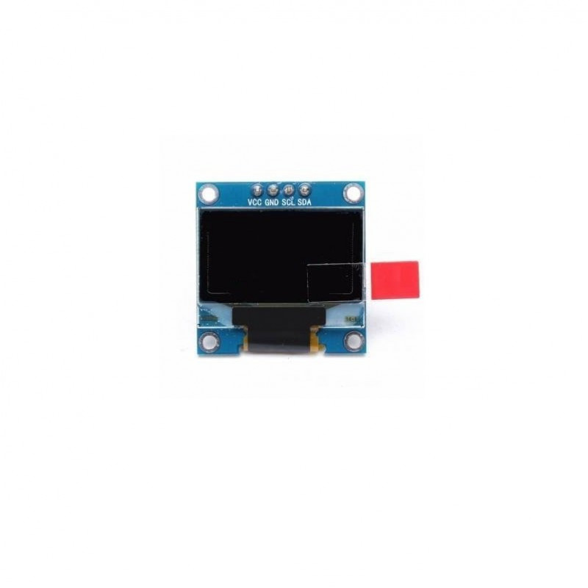
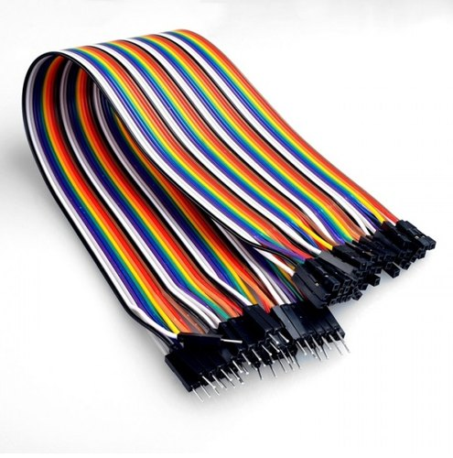
COMPONENTS
128*64 I2C OLED DISPLAY
JUMPER WIRES

Slide 11
BLOCK DIAGRAM
FIG.1
WEB SERVER
WEB
ESP32
USB
WIFI MODULE
SENSOR 1
SENSOR 2
SENSOR 3
TEMPERATURE AND HUMIDITY SENSOR
BAROMETRIC PRESSURE SENSOR
RAIN SENSOR
MODULE 1
MODULE 2
MODULE 3

Slide 12
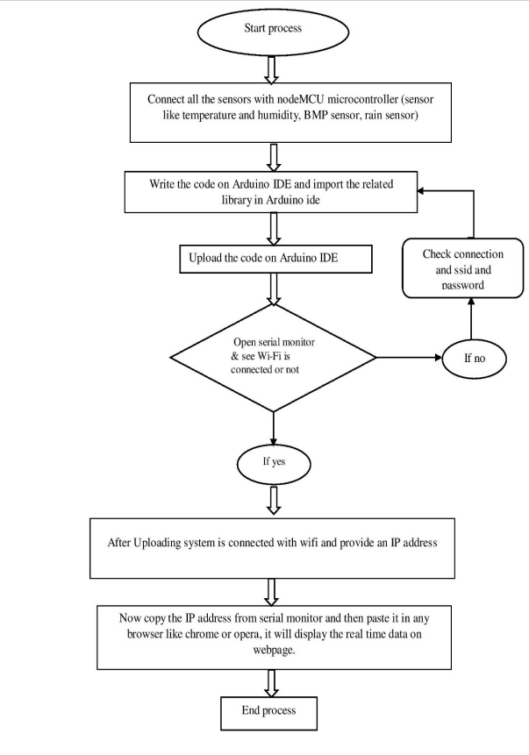
FLOW CHART OF THE PROPOSED SYSTEM

Slide 13
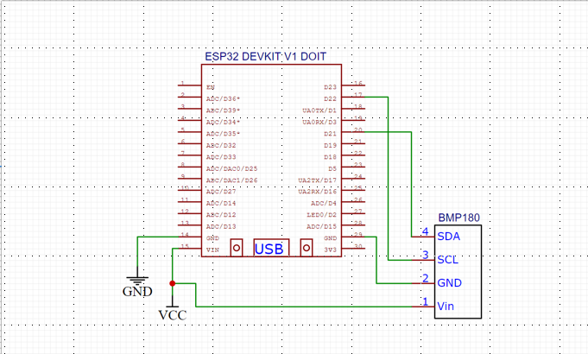
CIRCUIT DIAGRAMS
CONNECTION OF BMP180 WITH ESP32

Slide 14
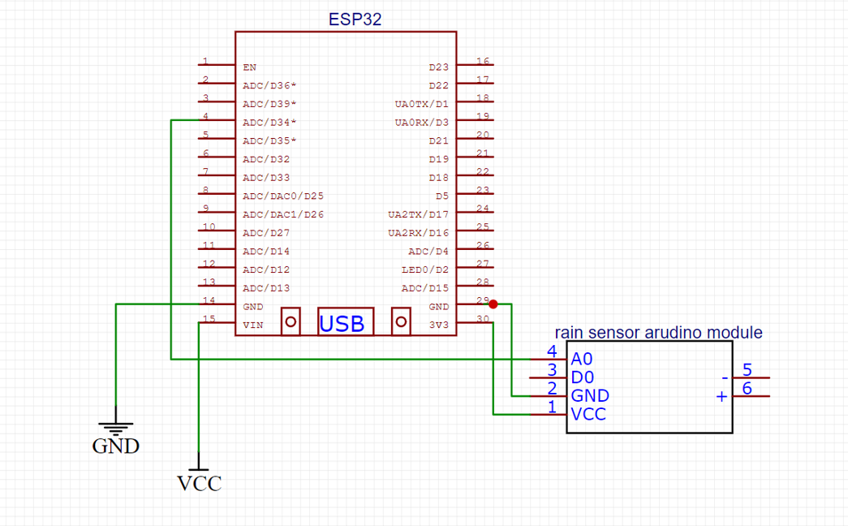
CIRCUIT DIAGRAMS
CONNECTION OF RAIN SENSOR MODULE WITH ESP32

Slide 15
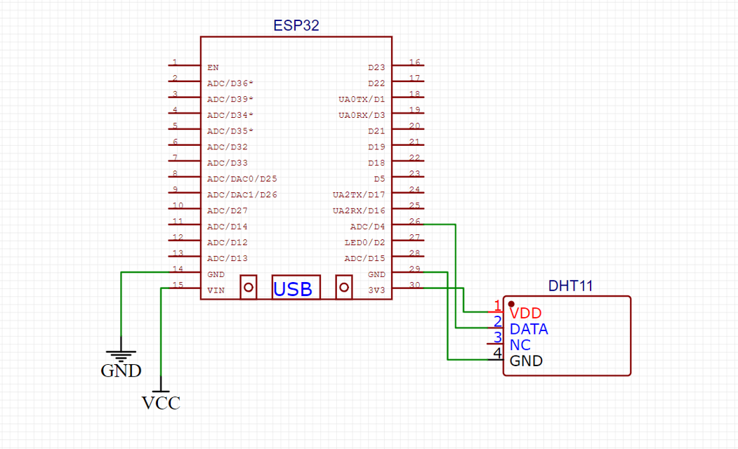
CIRCUIT DIAGRAMS
CONNECTION OF DHT11 WITH ESP32

Slide 16
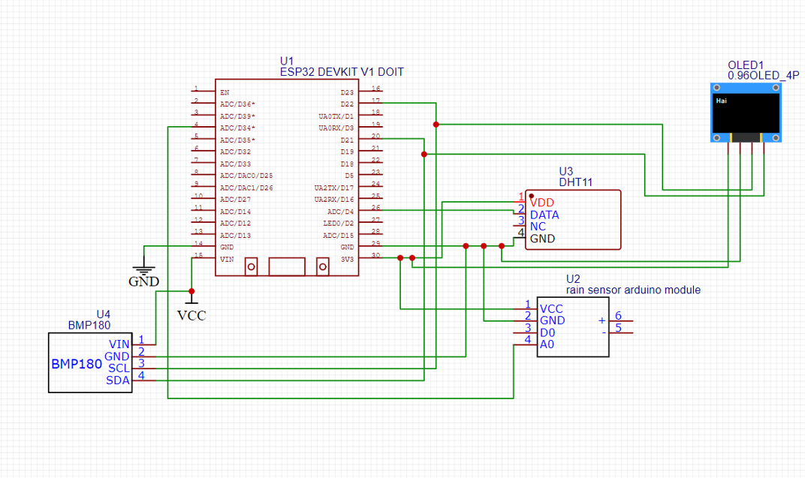
CIRCUIT DIAGRAMS
COMPLETE CIRCUIT DIAGRAM WITH ALL SENSOR MODULES

Slide 17
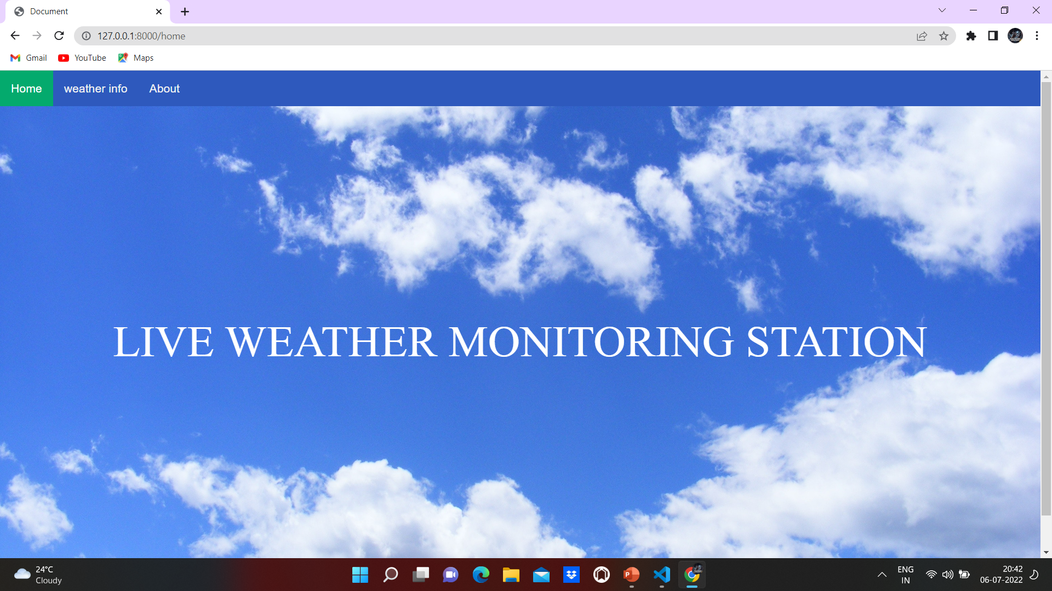
SCREENSHOTS

Slide 18
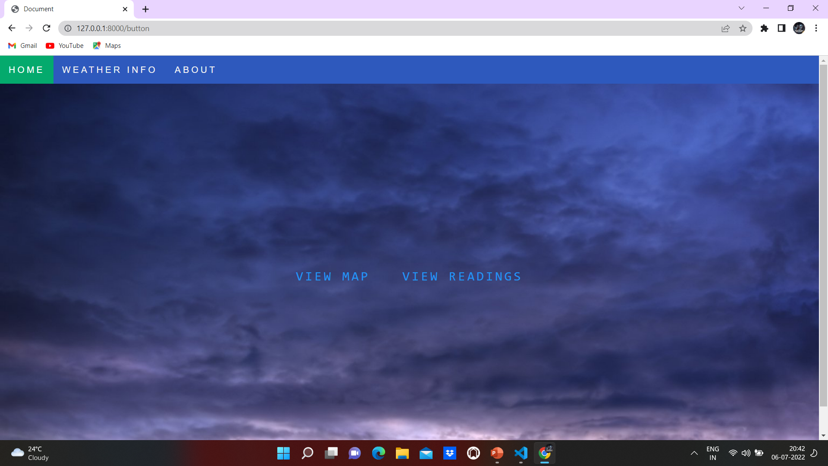

Slide 19
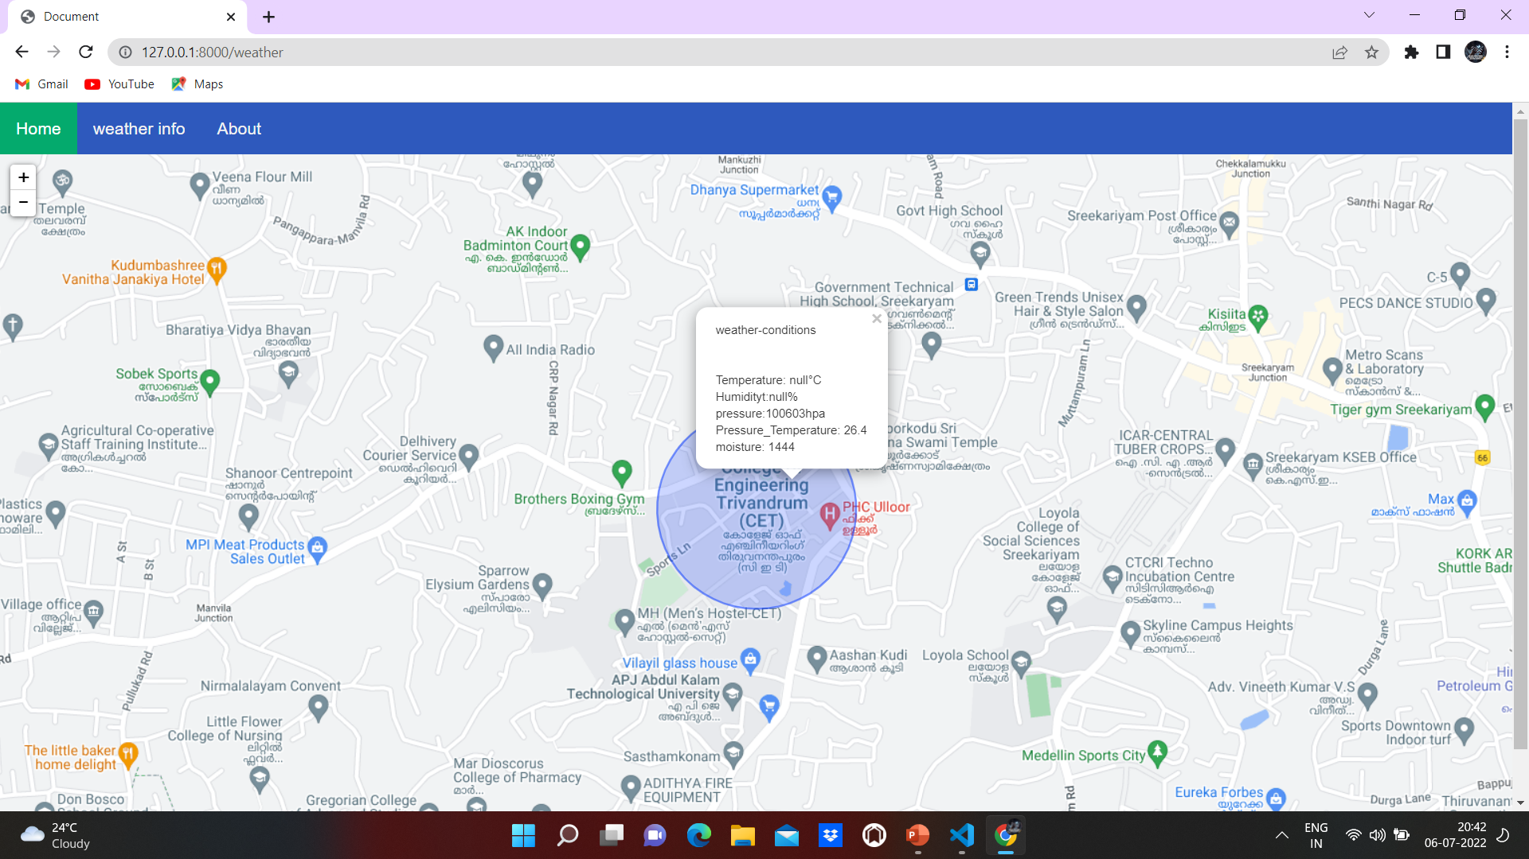

Slide 20
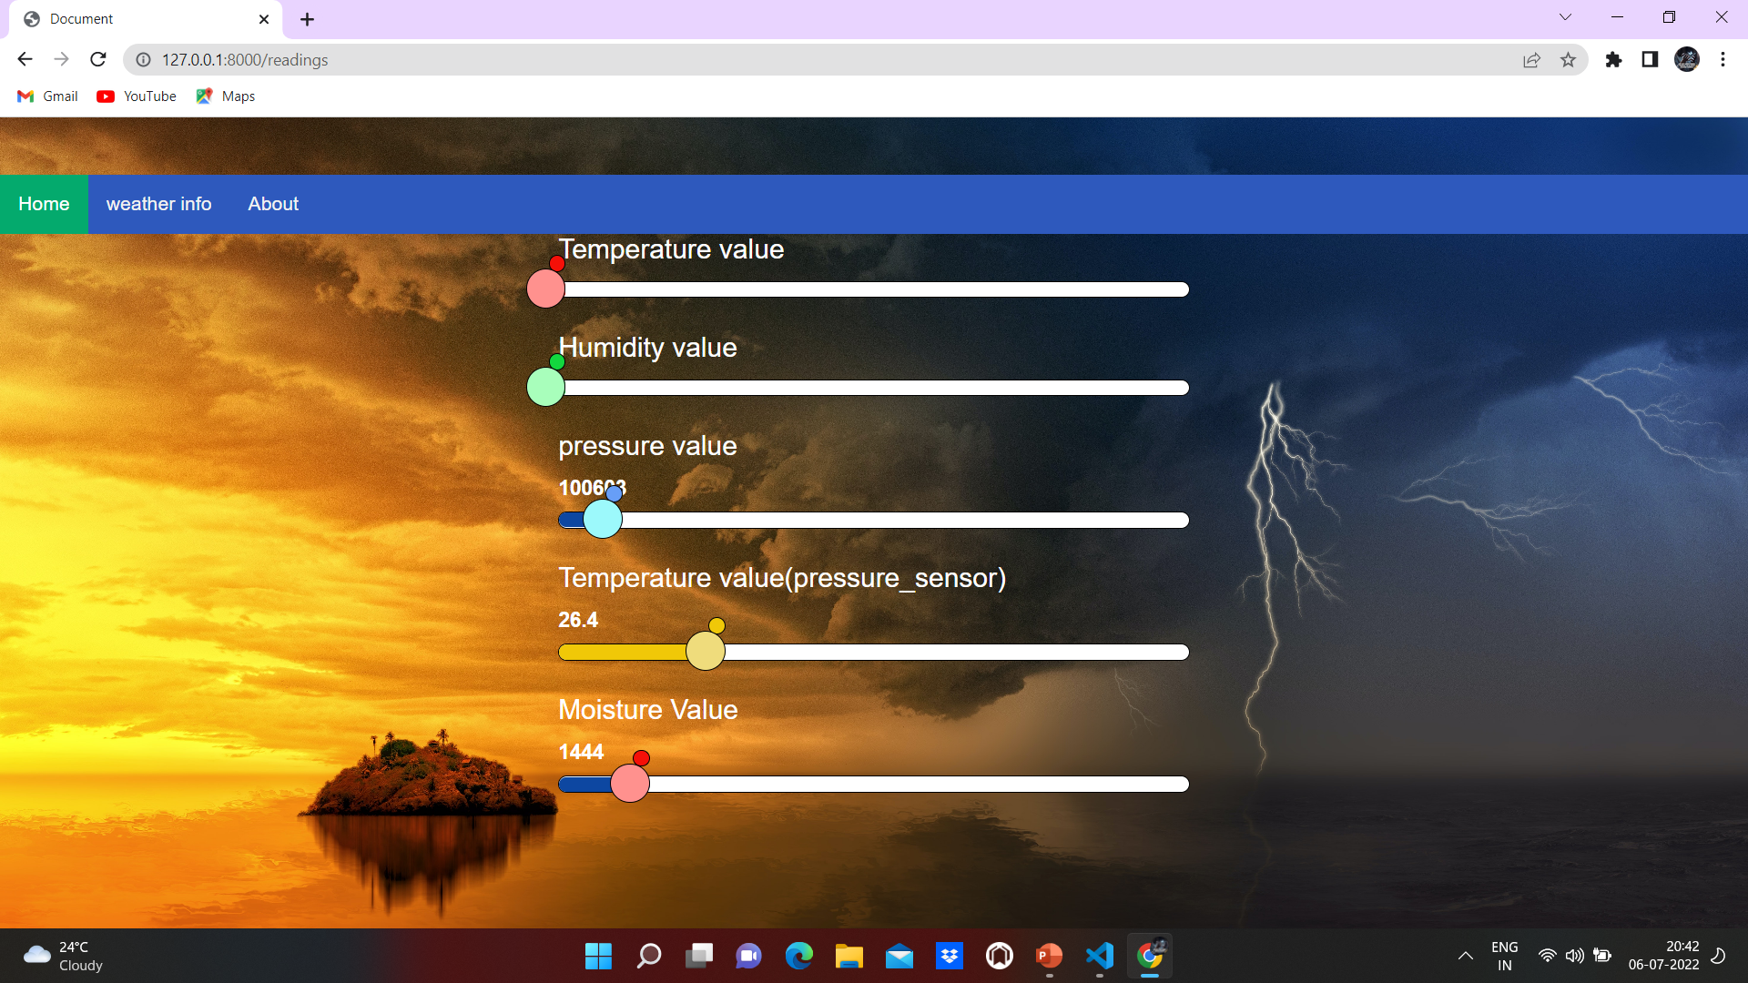

Slide 21
TECHNOLOGIES USED
ARDUINO IDE
The open-source Arduino Software (IDE) makes it easy to write code and upload it to the board.
This software can be used with any Arduino board
The Arduino programming language is based on a very simple hardware programming language called processing, which is similar to the C language.
Inexpensive.
Open source in hardware.
Open source in software.
IDE Software operate on any operating system.

Slide 22
DJANGO
Django is a web application framework written in Python programming language.
It is based on MVT (Model View Template) design pattern.
The Django is very demanding due to its rapid development feature.
It takes less time to build application after collecting client requirement.
This framework uses a famous tag line: The web framework for perfectionists with deadlines

Slide 23
HTML & CSS
HTML (the Hypertext Markup Language) and CSS (Cascading Style Sheets) are two of the core technologies for building Web pages.
HTML provides the structure of the page, CSS the (visual and aural) layout, for a variety of devices.
HTML is easy to Learn and Use
Supported by all browsers
Can easily Integrate with other languages
CSS provides consistent designs
Provide more website Speed

Slide 24
CONCLUSION
Devices that monitor weather’s parameters with minimum cost in our proposed system. The proposed system works on the client-side architecture model. The proposed approach observed various environmental information using multiple sensors. The system which is designed has used less sensor than the existing model. The main aim of our proposed model is to make the system cost-effective, affordable. So that everyone can use it freely. In our proposed system, capturing multiple data from multiple sensors and send all the data to the webpage by HTTP request protocol on the webserver.
After detection the data from different sensors, the sensed data will be automatically send to the web server, when proper connection is recognized with server device, the web server page will allow us to monitor and control the system. Entering IP address of server which is placed for monitoring we will get equivalent web page. The web page gives the information of the weather parameters in that particular region, where the monitoring system is placed.

Slide 25
FUTURE SCOPE
The IOT Based weather Informative System will proposed to Real time Applications.
It doesn’t need of any data centers physically because of we are creating a data Server so that it doesn’t require any datacenter further.
So It Reduces the Cost of Equipment.
In some area, it will be challenging to check and monitor the vital weather parameter through wires and analogue devices during some weather hazards.
We can resolve the problem by using electronic sensors, used to review and monitor the weather parameters.
We can extend the proposed system to a higher level by detecting more weather parameters.
We can establish the system into more rural areas.

Slide 26
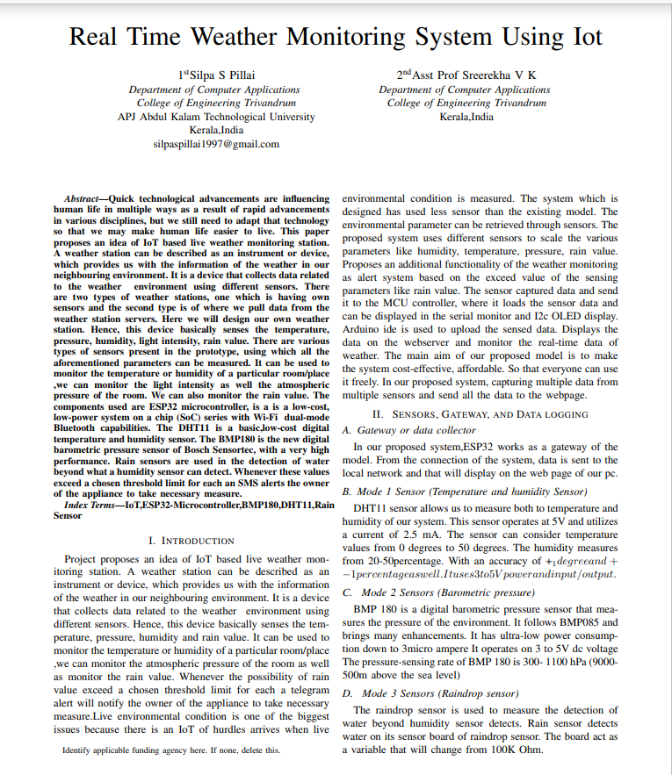
JOURNAL PUBLISHING

Slide 27
REFERENCES
Puja Sharma, Shiva Prakash “Real Time Weather Monitoring System Using Iot”ITM Web of Conferences 40, 01006 (2021) Department of Information Technology and Computer Application ,Madan Mohan Malaviya University of Technology, Gorakhpur.
Roopa M L, Varsharani, Prathima S M, Rashmi H C” IOT based Real Time Weather Predication System using NODEMCU 12-E ESP266 and Lab” International Journal of Engineering Research & Technology (IJERT), ISSN: 2278-0181,NCCDS – (2021) Conference Proceedings.
Jamal Mabrouki , Mourade Azrour, Driss Dhiba, Yousef Farhaoui,Souad El Hajjaji” IoT-Based Data Logger for Weather Monitoring Using Arduino-Based Wireless Sensor Networks with Remote Graphical Application and Alerts” ISSN 2096-0654 04/07 pp25–32 Volume 4, Number 1, March 2021 DOI: 10.26599/BDMA.2020.9020018.

Slide 28
THANK YOU

